Slide 1

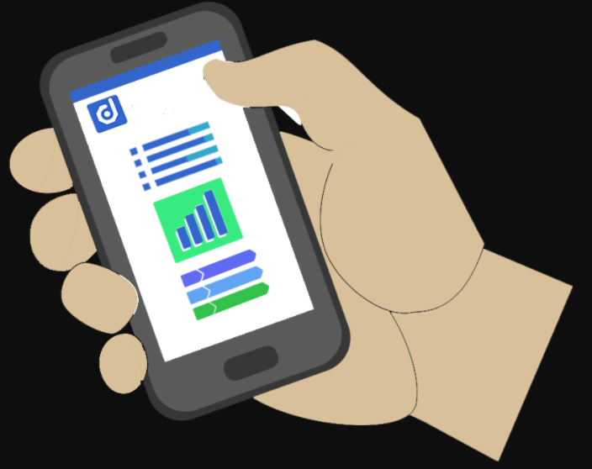
POCKET HEDGE FUND By: Chris Lee, Chris Wong, Jacob Feldman, Kim Austria & Val De Franco
POCKET HEDGE FUND’

Slide 2
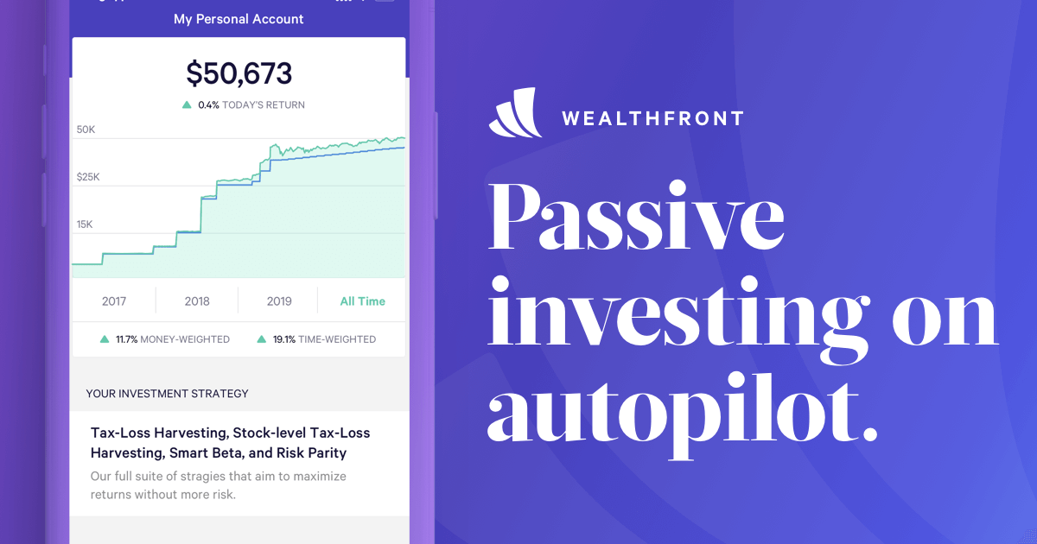


CURRENT LANDSCAPE
POCKET HEDGE
FUND
Most popular Robo-Advisors:
Wealthfront
Betterment
Interactive Advisors

Slide 3
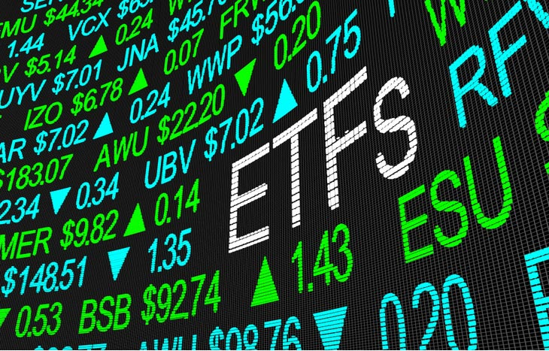
WHAT THEY DO
POCKET HEDGE
FUND
Determine an investor’s risk tolerance through questionnaires and create the optimal portfolio of ETFs matching the risk tolerance level
ETF’s asset classes offerings vary across companies
Investors are free to change their risk tolerance level, within the app or website provided, without having to consult an advisor
Majority provides tax-loss harvesting

Slide 4





THE PROBLEM
POCKET HEDGE
FUND
Cost
Focus
1. Charges a fee on top of the ETF’s fund fee •As much as $40 per $10,000 invested annually
2. Focuses only on ETFs

Slide 5

TOPIC
POCKET HEDGE
FUND
Set up an application that helps smaller retail investors/traders with data analysis and graphical output to help them make better investment decisions

Slide 6

POCKET HEDGE FUND INDICATORS
POCKET HEDGE
FUND
Simple stock analysis through API’s and databases
Free robo-advisor that helps investors navigate individual stock analysis
Trading strategies

Slide 7


DATA SOURCES AND LIBRARIES
POCKET HEDGE
FUND
The following data sources were used:
Alpaca
Trading data
Compustat
Valuation data
The following libraries were used:
TA-lib
Tkinter

Slide 8

POCKET HEDGE
FUND
CHOOSE YOUR
PORTFOLIO

Slide 9
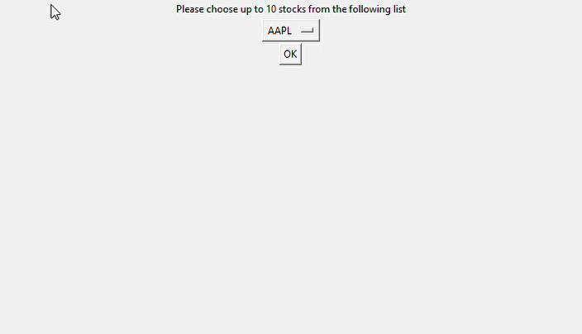
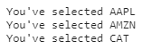
BUILDING YOUR PORTFOLIO
POCKET HEDGE
FUND
Drop down menu will pop up with the option to choose up to 10 stocks for your portfolio
Once chosen the following message will appear with the selected stocks

Slide 10
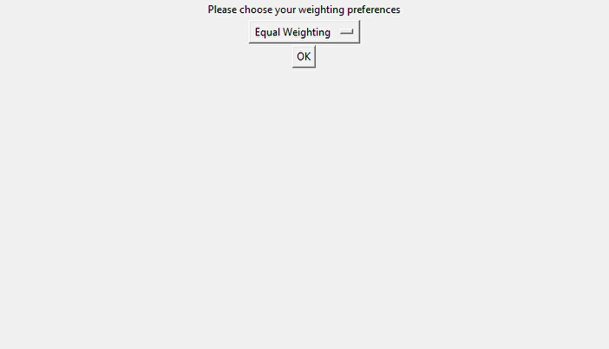
WEIGHT PREFERENCE
POCKET HEDGE
FUND
Drop down menu will pop up the option to choose up to 10 stocks for your portfolio
If equal weight is chosen then the portfolio will equally divide the chosen stocks

Slide 11
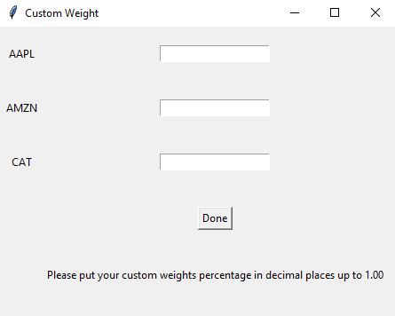
CUSTOM WEIGHT PREFERENCE
POCKET HEDGE
FUND
If custom weight is chosen then the following prompt will appear for the investor to choose weight preference

Slide 12



METHODS
POCKET HEDGE
FUND
Returns
Risk
Composite
Daily Return
Holding Period Return
Daily Cumulative Return
Volatility
Correlation
Sharpe Ratio
Mean Reversion
Historical Valuation

Slide 13
POCKET HEDGE
FUND
RETURNS

Slide 14
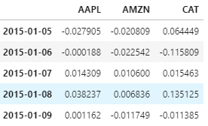
DAILY RETURN
POCKET HEDGE
FUND
Daily return measures the dollar change in a stock’s price as percentage value on the basis of the prior day’s closing price.
An increase = growth
A decrease = loss

Slide 15
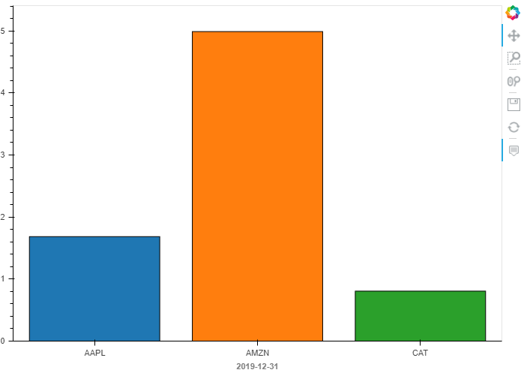
HOLDING PERIOD RETURN
POCKET HEDGE
FUND
Holding period return is useful for comparing returns between investments held for different periods of time

Slide 16
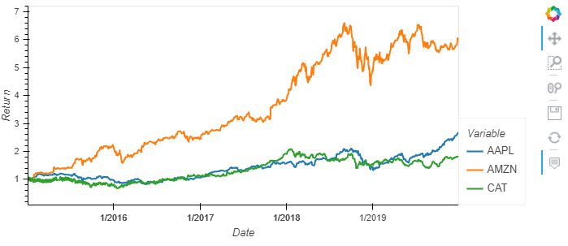
DAILY CUMULATIVE RETURN
POCKET HEDGE
FUND
Daily cumulative return is the aggregate amount that the investment has gained or lost over time

Slide 17
POCKET HEDGE
FUND
RISKS

Slide 18
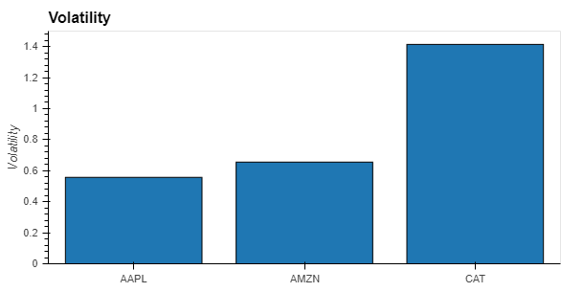
VOLATILITY
POCKET HEDGE
FUND
Volatility is the amount of uncertainty or risk related to the size of changes in a security’s value

Slide 19
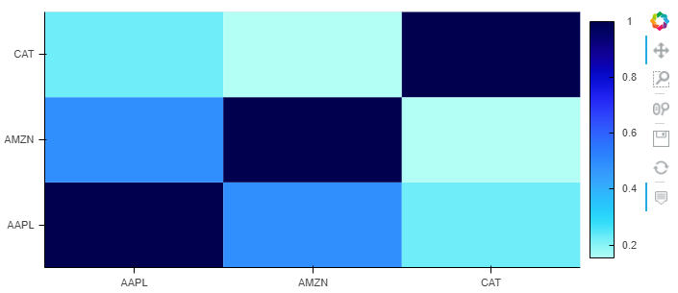
CORRELATION
POCKET HEDGE
FUND
Correlation is the relationship that exists between two or multiple stocks and their respective price movements

Slide 20
POCKET HEDGE
FUND
COMPOSITES

Slide 21
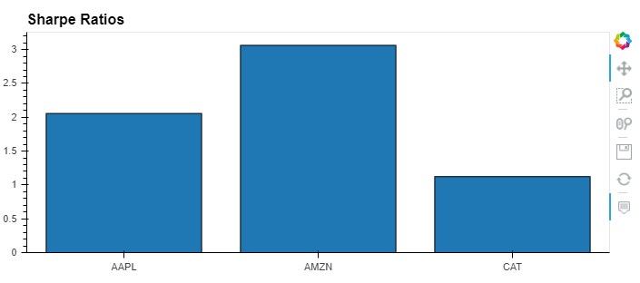
SHARPE RATIO
POCKET HEDGE
FUND
Sharpe ratio helps investors understand the return on investment compared to its risk
The higher the ratio based on past performance the better

Slide 22
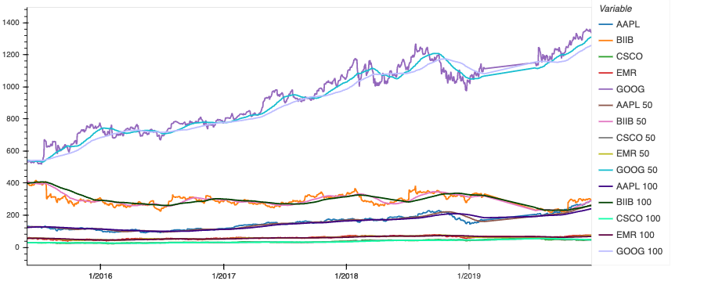
MEAN REVERSION
POCKET HEDGE
FUND
Mean reversion is the assumption that a stock's price will tend to move to the average price over time

Slide 23
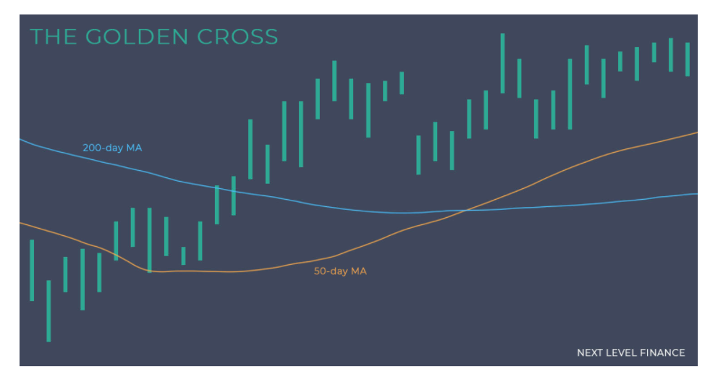
MEAN REVERSION
POCKET HEDGE
FUND

Slide 24
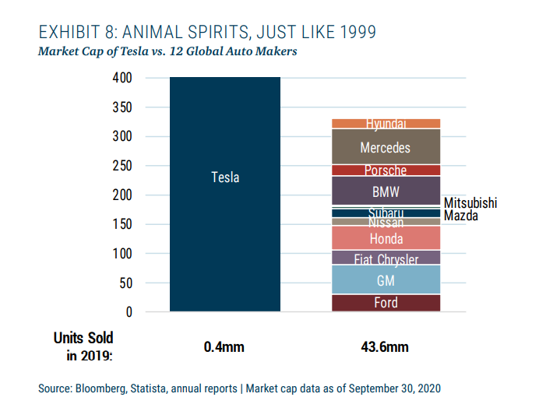
HISTORICAL VALUATION
POCKET HEDGE
FUND

Slide 25
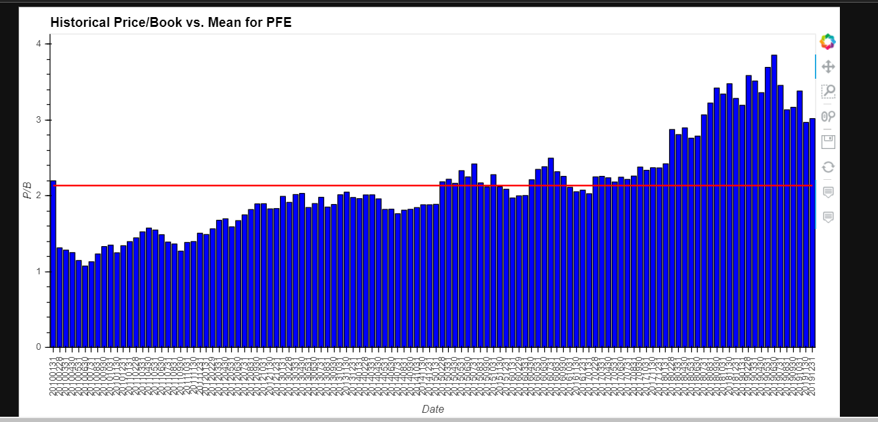
HISTORICAL VALUATION
POCKET HEDGE
FUND

Slide 26
HISTORICAL VALUATION
POCKET HEDGE
FUND
For each stock selected by user
Price to diluted earnings
Price to sales
Price to book
10 years of monthly historical data vs. the mean
Allows user to compare current valuation with historical range

Slide 27
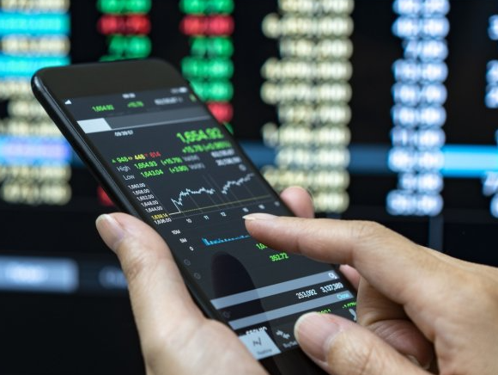
TRADING STRATEGIES
POCKET HEDGE
FUND
Rules for inclusion based off user risk preferences
Risk preferences are embedded with strategy thresholds for inclusion or exclusion
The strategies are:
Volatility
Moving average crosses
Sharpe ratio
Correlation
Valuation

Slide 28

Summary/ RECOMMENDATIONS
POCKET HEDGE
FUND
If a given stock does not meet our established thresholds for inclusion, we provide alternative stock recommendations based off the user’s risk preference and our trading strategies

Slide 29
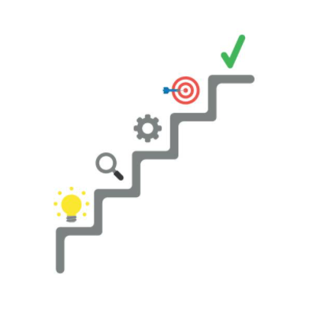
NEXT STEPS
POCKET HEDGE
FUND
Import a mobile app GUI library, like Django and Kivy to develop the code into a mobile app
As real time information is updated in the API we are confident that our trading strategies can be overlaid with retail trading applications (i.e. Wealth Simple, Quest Trade and Revolut) to rebalance portfolios and optimize returns
To develop and include a natural language processing component to our trading strategies, where we predict inflated stock valuations based off internet searches and social media mentions

Slide 30
Thank You ANY QUESTIONS
POCKET HEDGE
FUND

